Slide 1
University of Wisconsin Courses SQL Project
By Kevin Sheahen

Slide 2
Overview
The purpose of this project is just a refresher of the SQL language for my personal career development
So, it is quite simple
The data in this project represents University of Wisconsin Courses and Grades from 2006-2017
It encompasses 10 tables with unique keys for joining
Here’s the link to the dataset on Kaggle
Link

Slide 3
INSTRUCTORS
id | INT
name | STR
COURSE OFFERINGS
uuid | STR
course_uuid | STR
term_code | STR
name | STR
TEACHINGS
Instructor_id | INT
section_uuid | STR
SECTIONS
uuid | STR
course_offering_uuid | STR
section_type | STR
number | INT
room_uuid | STR
schedule_uuid | STR
COURSES
uuid | STR
name | STR
number | INT
GRADE_DISTRIBUTIONS
course_offering_uuid | STR
section_number | INT
a_count | INT
ab_count | INT
b _count | INT
bc_count | INT
c_count | INT
d_count | INT
f_count | INT
s_count | INT
u_count | INT
cr_count | INT
n_count | INT
p_count | INT
i_count | INT
nw_count | INT
nr_count | INT
other_count | INT
ROOMS
uuid | STR
facility_code | STR
room_code | STR
SCHEDULES
uuid | STR
start_time | INT
end_time | INT
mon | BIT
tues | BIT
wed | BIT
thurs | BIT
fri | BIT
sat | BIT
sun | BIT
SUBJECT_MEMBERSHIPS
subject_code | STR
course_offering_uuid | STR
SUBJECTS
code | STR
name | STR
abbreviation | STR

Slide 4
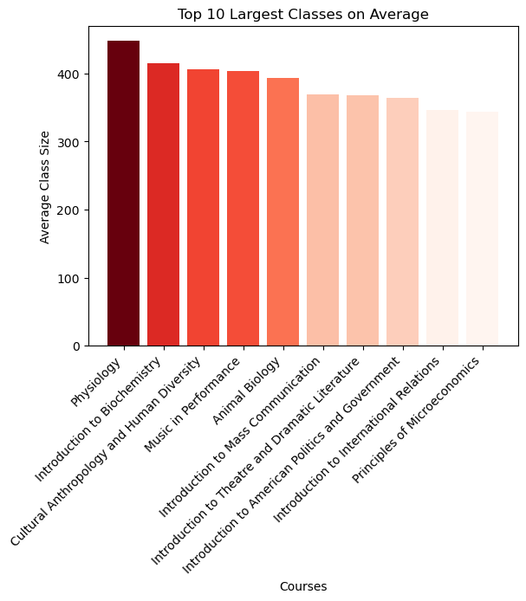
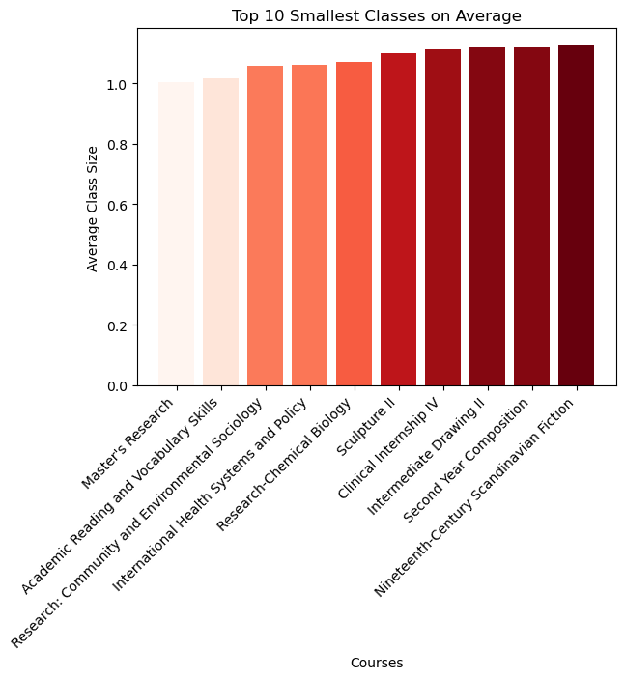
Course Profile
The most in demand class on average was Physiology
447.67 Students
“Introduction to Biochemistry”, “Music in Performance” and others were in the top 10 (Top Right Image)
The lowest in demand classes on average was Master’s Research
1 Student (* Condition of 1 student)
“Research-Chemical Biology”, “Sculpture II”, “Clinical Internship IV”

Slide 5
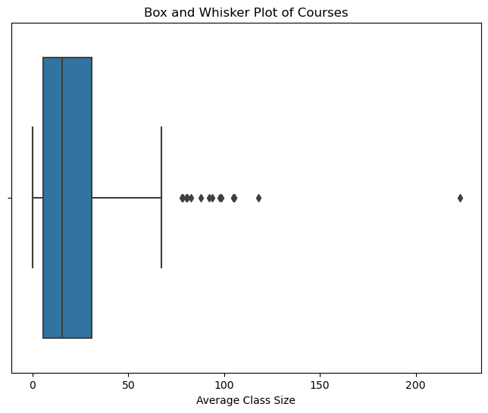
Distribution of Course Size
The Median Course Size sits below 25 students
There are about a dozen outlier classes
These Outliers seem to range from 75 to over 200 students

Slide 6
Analysis
Most Failed Subjects based on Percentage
Mathematics 3.8% , Computer Sciences 3.25%, Engineering Mechanics and Astronautics 2.98%
Subject with the highest concentration of A’s
Art Education (Department of Art) 93.7%, Military Science 87%, Rehabilitation Psychology and Special Education 86.5%
Teacher Count
18,599 Unique Teachers
Course Count
7,921
Room Count
1,350

Slide 7
Further Developments
This data project could be improved by bringing the data into Tableau or Power BI
Slicing and Dicing the data would unlock more trends and insights
Development on a professional level would be certification and/or further experience with enterprise level data

